Slide 1
PHP
Outline
1 Introduction
2 PHP
3 String Processing and Regular Expressions
4 Viewing Client/Server Environment Variables
5 Form Processing and Business Logic
6 Verifying a Username and Password
7 Connecting to a Database
8 Dynamic content in php

Slide 2
INTRODUCTION
PHP
  PHP: Hypertext Preprocessor
  Originally called “Personal Home Page Tools”
  Popular server-side scripting technology
  Open-source
    Anyone may view, modify and redistribute source code
    Supported freely by community
  Platform independent
  Interaction with database.

Slide 3
PHP
Basic application
  Scripting delimiters
    <? php ?>
    Must enclose all script code
  Variables preceded by $ symbol
    Case-sensitive
  End statements with semicolon
  Comments
    // for single line
    /* */ for multiline
  Filenames end with .php by convention

Slide 4
EXAMPLE 1
<!DOCTYPE html>
<html>
<body>
<?php
echo "My first PHP script!";
?>
</body>
</html>

Slide 5
STRING FUNCTIONS
<html><body>
<?php
echo strlen("Hello world!");
//output = 12
echo str_word_count("Hello world!");
// outputs 2
echo strrev("Hello world!");
//echo print(“rev =“!dlrdow olleH);
echo strpos("Hello world!", "world");
// outputs 6
echo str_replace("world", "Dolly", "Hello world!");
// outputs Hello Dolly!
?>
</body></html>

Slide 6
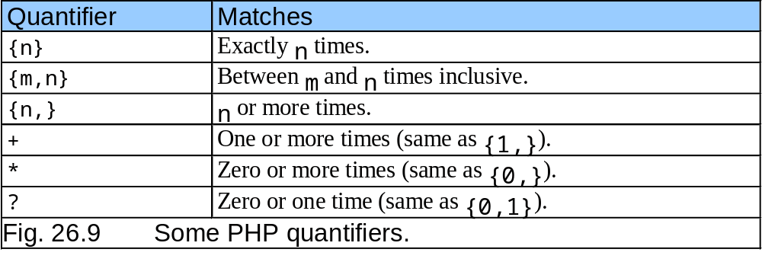
REGULAR EXPRESSIONS

Slide 7
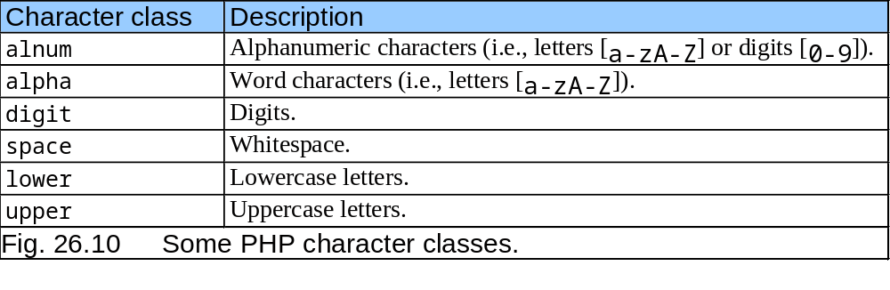
REGULAR EXPRESSIONS CONTD…

Slide 8
REGEX EXAMPLE 1
you can use the preg_match() function to test whether a regular expression matches a specific string. Note that this function stops after the first match, so this is best suited for testing a regular expression more than extracting data.

Slide 9
PREG_MATCH()
<html> <body><?php
// Lets use a regular expression to match a date string. Ignore
// the output since we are just testing if the regex matches.
$regex = "/[a-zA-Z]+ \d+/";
if (preg_match($regex, "June 24")) {
// Indeed, the expression "[a-zA-Z]+ \d+" matches the date string
echo "Found a match!";
} else {
// If preg_match() returns false, then the regex does not
// match the string
echo "The regex pattern does not match. :(";
}
?>
</body></html>>

Slide 10
REGULAR EXPRESSION
'/regex/i 'applies the regex case insensitively.
'/regex/s' makes the dot match all characters.
'/regex/is' turns on all four options

Slide 11
REGULAR EXPRESSION
preg_match() :The preg_match() function searches string for pattern, returning true if pattern exists, and false otherwise.
preg_match_all():The preg_match_all() function matches all occurrences of pattern in string.
preg_split():The preg_split() function operates exactly like split(), except that regular expressions are accepted as input parameters for pattern.
preg_grep():The preg_grep() function searches all elements of input_array, returning all elements matching the regexp pattern.

Slide 12
STRING PROCESSING
String processing
  Equality and comparison two important operations
  strcmp function
    Returns –1 if string 1 < string 2
    Returns 0 if string 1 = string 2
    Returns 1 if string 1 > string 2
  Relational operators
  <, >, =

Slide 13
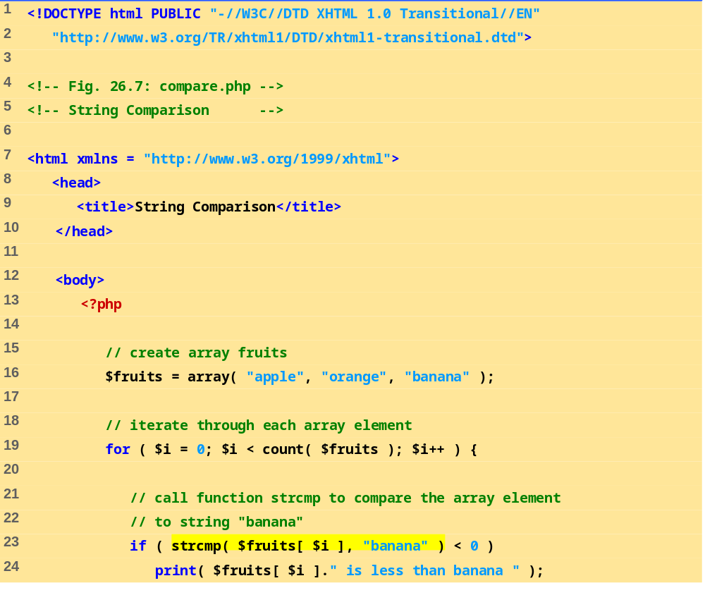
COMPARE.PHP
(1 OF 2)
Use a for loop to iterate through each array element.
Function strcmp compares two strings. If the first string alphabetically precedes the second, then –1 is returned. If the strings are equal, 0 is returned. If the first string alphabetically follows the second, then 1 is returned.

Slide 14
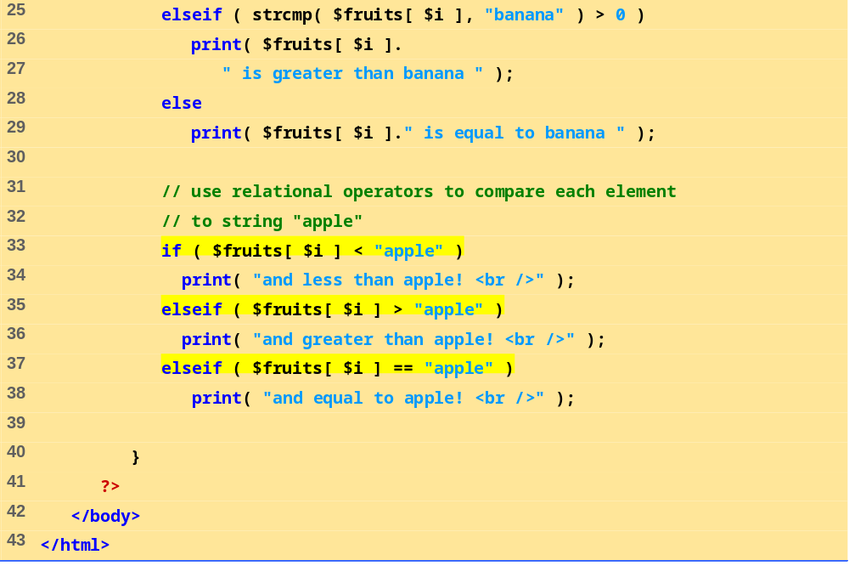
Use relational operators to compare each array element to string “apple”.

Slide 15
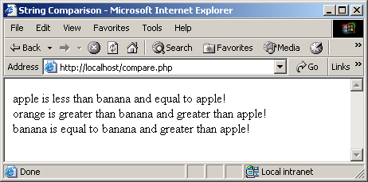
STRING PROCESSING AND REGULAR EXPRESSIONS
Fig. Using the string comparison operators.

Slide 16
VARIABLES
Variables
  Can have different types at different times
  Variable names inside strings replaced by their value
  Type conversions
    settype function
    Type casting
  Concatenation operator
    . (period)
    Combine strings

Slide 17
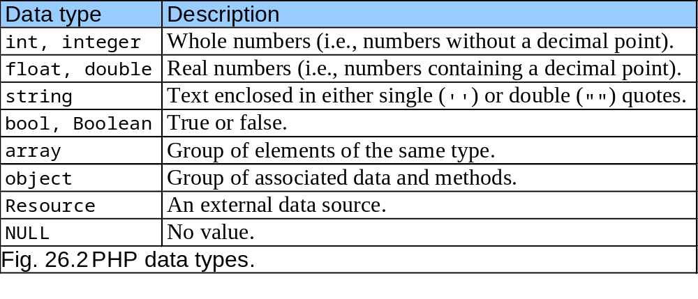

Slide 18
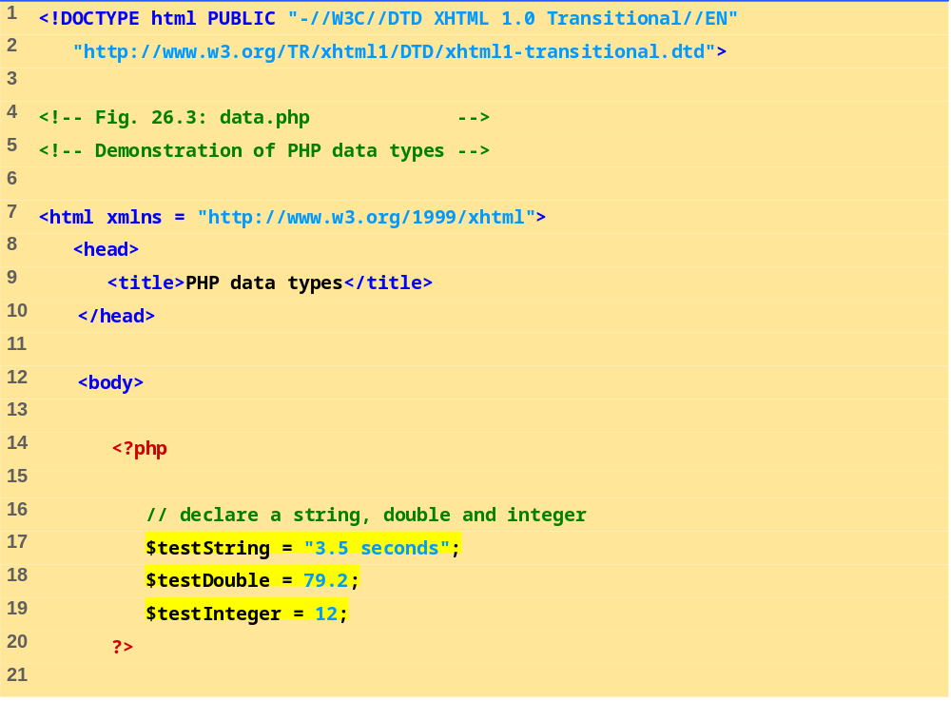
DATA.PHP
(1 OF 3)
Assign a string to variable $testString
Assign a double to variable $testDouble
Assign an integer to variable $testInteger

Slide 19
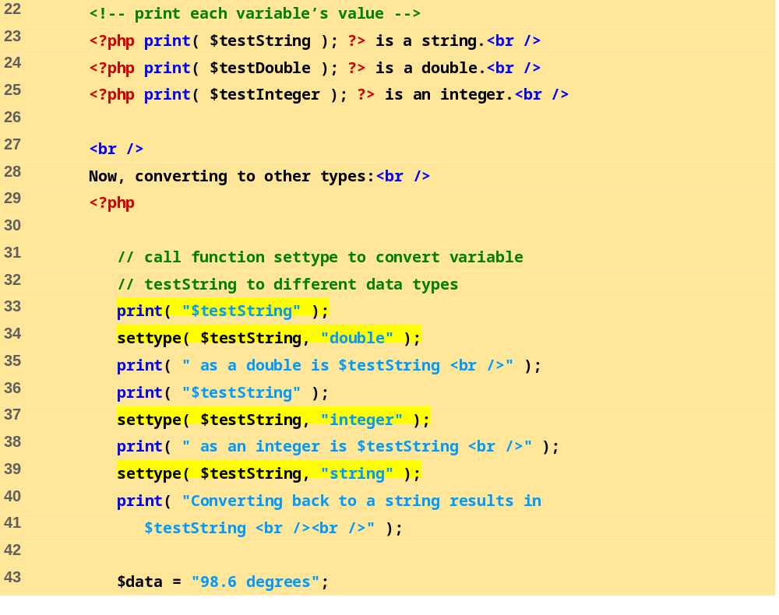
DATA.PHP
(2 OF 3)
Print each variable’s value
Call function settype to convert the data type of variable $testString to a double.
Call function settype to convert the data type of variable $testString to an integer.
Convert variable $testString back to a string

Slide 20
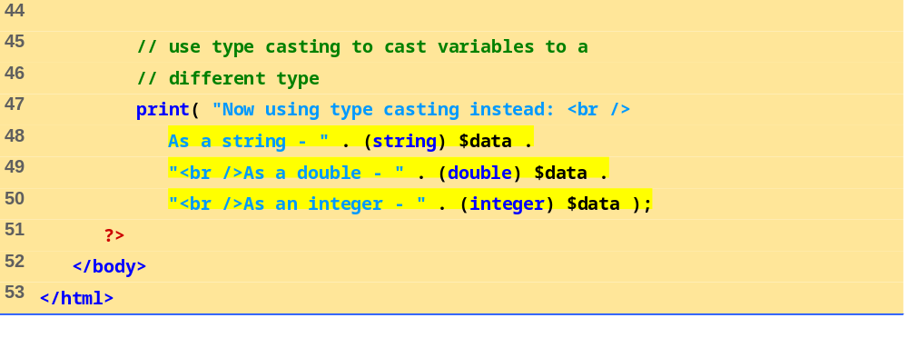
Use type casting to cast variable $data to different types

Slide 21
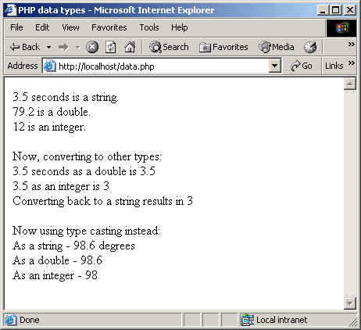

Slide 22
26.2 PHP
Arithmetic operators
  Assignment operators
    Syntactical shortcuts
    Before being assigned values, variables have value undef
Constants
  Named values
  define function

Slide 23
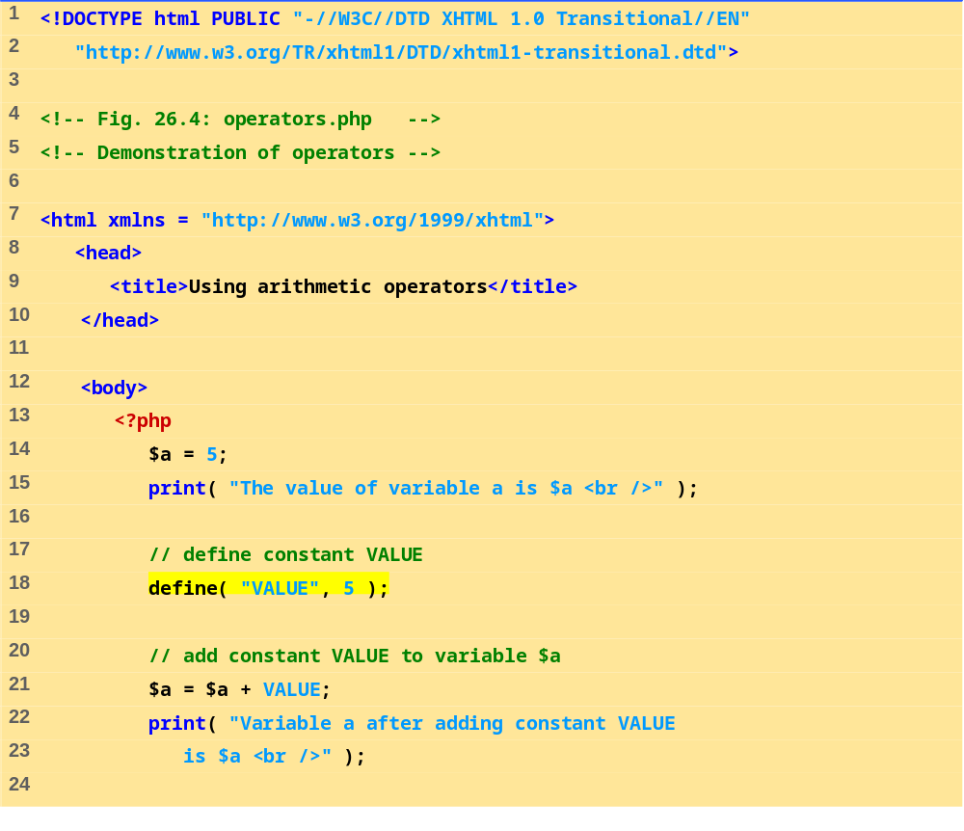
Define constant VALUE.
Add constant VALUE to variable $a.

Slide 24
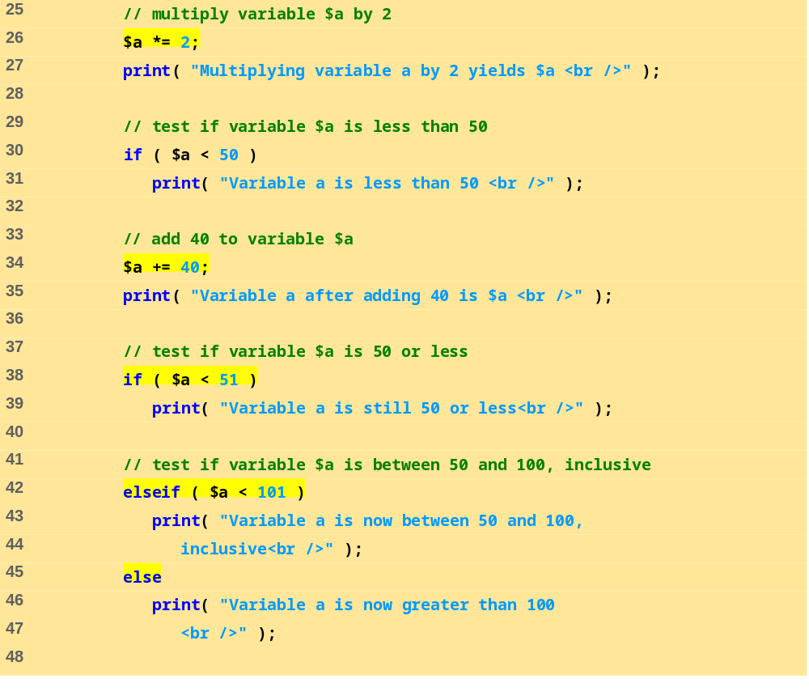
OPERATORS.PHP
(2 OF 3)
Multiply variable $a by two using the multiplication assignment operator *=.
Test whether variable $a is less than 50
Print if variable $a is less than 50.
Add 40 to variable $a using the addition assignment operator +=.

Slide 25
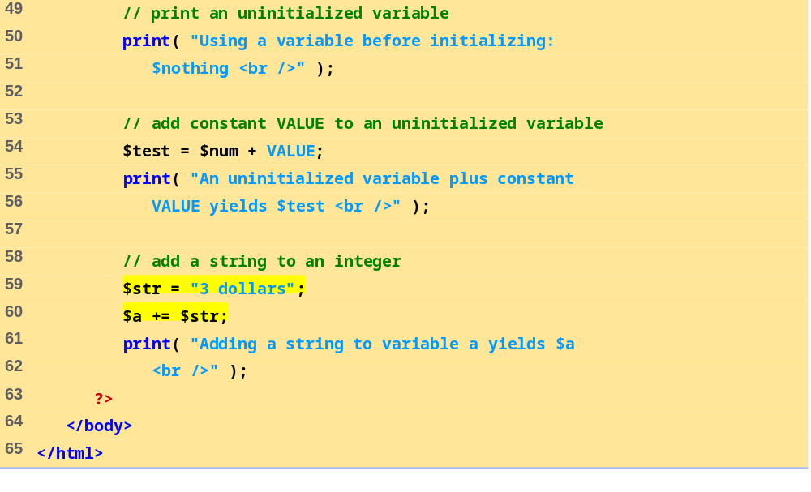
Print an uninitialized variable ($nothing).
Add constant VALUE to an uninitialized variable.
Add a string to an integer.

Slide 26
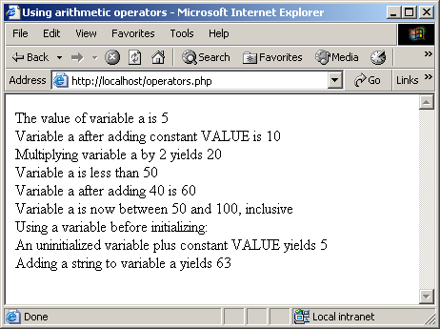
Using PHP’s arithmetic operators.

Slide 27
26.2 PHP
Keywords
  Reserved for language features
  if…elseif…else
Arrays
  Group of related data
    Elements
  Name plus braces and index
    Indices start at zero
  count function
  array function

Slide 28
PHP ARRAYS
Arrays, cont.
  Built-in iterators
    Maintain pointer to element currently referenced
    reset
    key
    next
    foreach loops

Slide 29
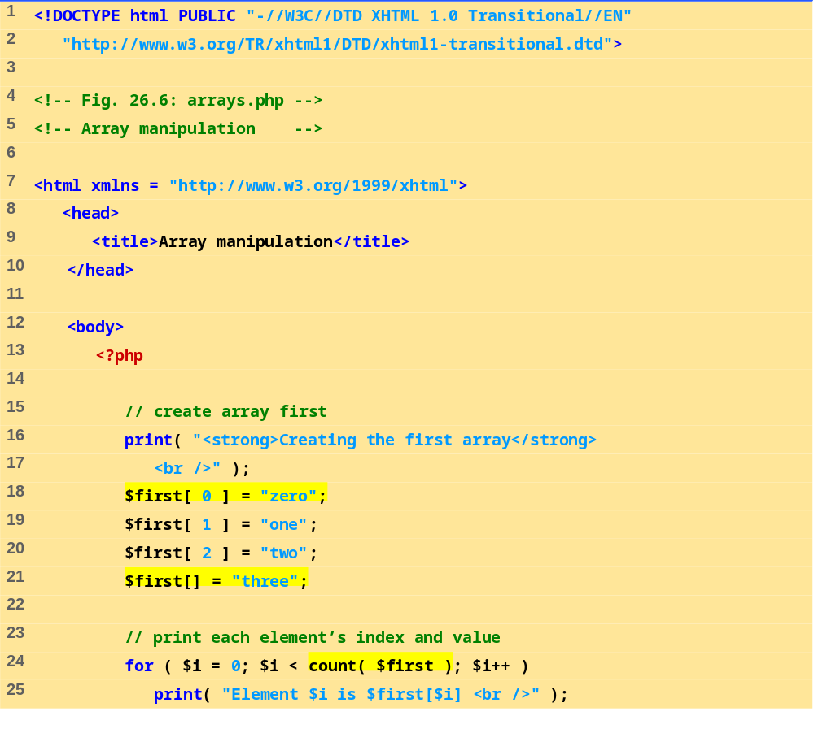
ARRAYS.PHP
(1 OF 3)
Create the array $first by assigning a value to an array element.
Assign a value to the array, omitting the index. Appends a new element to the end of the array.
Use a for loop to print out each element’s index and value. Function count returns the total number of elements in the array.

Slide 30
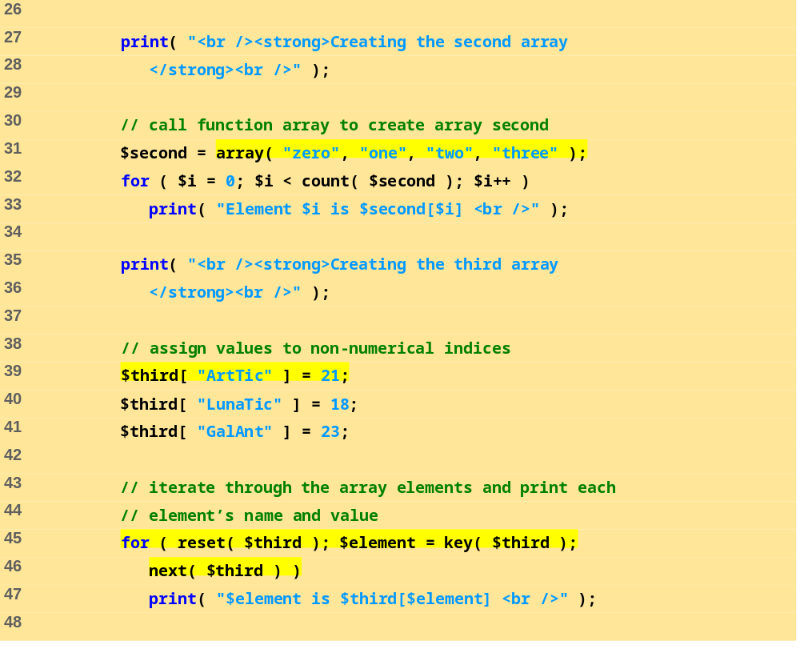
ARRAYS.PHP
(2 OF 3)
Call function array to create an array that contains the arguments passed to it. Store the array in variable $second.
Assign values to non-numerical indices in array $third.
Function reset sets the internal pointer to the first element of the array.
Function key returns the index of the element which the internal pointer references.
Function next moves the internal pointer to the next element.

Slide 31
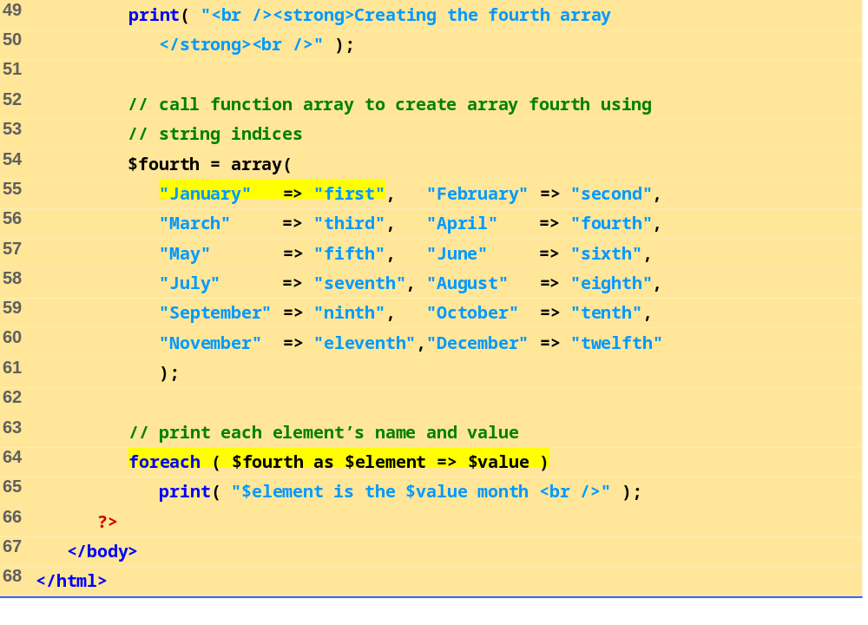
ARRAYS.PHP
(3 OF 3)
Operator => is used in function array to assign each element a string index. The value to the left of the operator is the array index, and the value to the right is the element’s value.

Slide 32
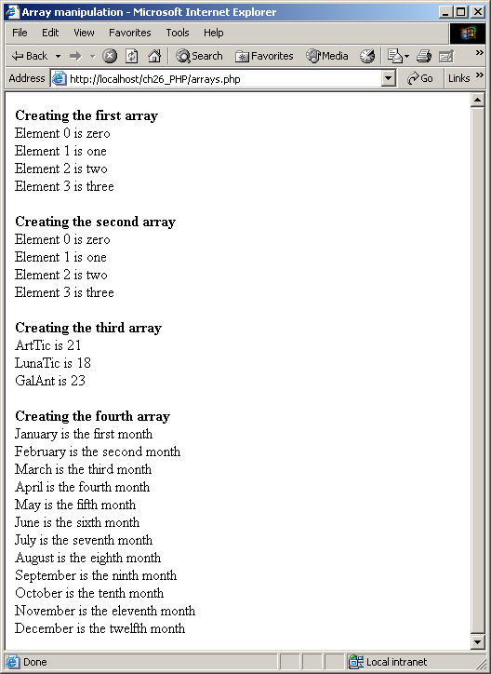
Array manipulation.

Slide 33
PHP AND DATABASE

Slide 34
PHP AND DATABASE
Mysql – popular open-source database management system
PHP usually works with Mysql for web-based database applications
LAMP applications—Web-based applications that use Lynux, Apache, Mysql, and php/pearl/python

Slide 35
BASIC STEPS TO PROCESS DB
Connect to host server which has Mysql installed
Select a database
Form an SQL statement
Execute the SQL statement and (optionally) return a record set
Extract data from recordset using php
Close connection

Slide 36
CONNECTION TO MYSQL & DATABASE (DB.PHP)
<?php
$hostname = "localhost";
$username = "root";
$password = "";
//connection to the mysql
$con = mysql_connect($hostname, $username, $password) ;
if (!$con){ die('Could not connect: '. mysql_error());}
//connection to the database
$dbName="test";
$db = mysql_select_db($dbName,$con);
?>

Slide 37
CREATE A DATABASE
SQL
  CREATE DATABASE database_name
PHP
$con = mysql_connect("localhost","peter",
"abc123");
$sql = “CREATE DATABASE myDB”;
mysql_query(“$sql”, $con));

Slide 38
CREATE A TABLE
SQL
  CREATE TABLE table_name
  (column_name1 data_type,
  column_name2 data_type,
  column_name3 data_type,
  ....
  )

Slide 39
CREATE A TABLE
<?php
include 'db.php';
// Create table
$sql = "CREATE TABLE Persons(
FirstName varchar(15),
LastName varchar(15),
Age int)";
// Execute SQL statement
mysql_query($sql, $con);
?>

Slide 40
EXECUTING A SELECT QUERY
SQL
SELECT colName1, colName2, colName3
FROM Persons;
PHP
include 'db.php';
$sql = "SELECT FirstName, LastName FROM Persons;";
$result = mysql_query($sql);

Slide 41
PRINTING RESULTS OF SQL STATEMENT
PHP
$result = mysql_query($sql);
while($row =
mysql_fetch_array($result)){
echo $row['FirstName'] . " " .
$row['LastName'];
echo "<br />";
}

Slide 42
INSERTING RECORD INTO TABLE
SQL
INSERT INTO table_name
VALUES (value1, value2, value3,...)
or
INSERT INTO table_name
(column1, column2, column3,...)
VALUES (value1, value2, value3,...)

Slide 43
INSERTING RECORD INTO TABLE
<?php
include 'db.php';
mysql_query("INSERT INTO Persons (FirstName,
LastName, Age)
VALUES ('Peter','Griffin','35')");
mysql_query("INSERT INTO Persons (FirstName,
LastName, Age)
VALUES ('Glenn', ‘Brown', '33')");
mysql_close($con);
?>

Slide 44
UPDATE RECORD
SQL
UPDATE table_name
SET column1=value, column2=value2,...
WHERE some_column = some_value;

Slide 45
UPDATE RECORD
<?php
$con = mysql_connect(“…",“…",“…");
if (!$con)
die('Could not connect’, mysql_error());
mysql_select_db("my_db", $con);
$sql = “UPDATE Persons
SET Age = ’36’
WHERE FirstName = ‘Peter’
AND LastName = “Griffin’”;
mysql_query($sql, $con);
mysql_close($con);
?>

Slide 46
DELETE RECORD
SQL
Delete table_name
WHERE some_column = some_value;

Slide 47
DELETE RECORD
<?php
$con = mysql_connect(“…",“…",“…");
if (!$con)
die('Could not connect: ' .
mysql_error());
mysql_select_db("my_db", $con);
$sql = “DELETE FROM Persons
WHERE FirstName = ‘Peter’
AND LastName = “Griffin’”);
mysql_query($sql, $con);
mysql_close($con);
?>

Slide 48
FORM PROCESSING AND BUSINESS LOGIC
Form processing
  action property
    Where to send form data
  method property
    post
  Each element has unique name
  One can use GET or POST, generally POST is preferred because there is no restriction on amount of data to be sent

Slide 49
INSERTING RECORD INTO TABLE
FROM HTML FORM
<html>
<body>
<form action="insert.php" method="post">
Firstname: <input type="text" name=“nameF" />
Lastname: <input type="text" name=“nameL" />
Age: <input type="text" name="age" />
<input type="submit" />
</form>
</body>
</html>

Slide 50
INSERTING RECORD INTO TABLE
FROM HTML FORM
<?php
$con = mysql_connect(“…",“…",“…");
if (!$con)
die('Could not connect: ' . mysql_error());
mysql_select_db("my_db", $con);
$sql="INSERT INTO Persons
(FirstName, LastName, Age)
VALUES ('$_POST[nameF]',
'$_POST[nameL]',
'$_POST[age]')";
if (!mysql_query($sql,$con))
die('Error: ' . mysql_error());
echo "1 record added";
mysql_close($con)
?>

Slide 51
FORM
<!DOCTYPE HTML>
<html>
<body>
<?php
$name = $_POST['name'];
echo "User Has submitted the form and entered this name : <b> $name </b>";
$age = $_POST['age'];
echo "age of the user is: <b> $age </b>";
echo "<br>You can use the following form again to enter a new name.";
?>
<form method="post" action=“insert2.php">
<input type="text" name="name"><br>
<input type = "text" name = "age"> <br>
<input type="submit" name="submit" value="Submit Form"><br>
</form></body></html>

Slide 52
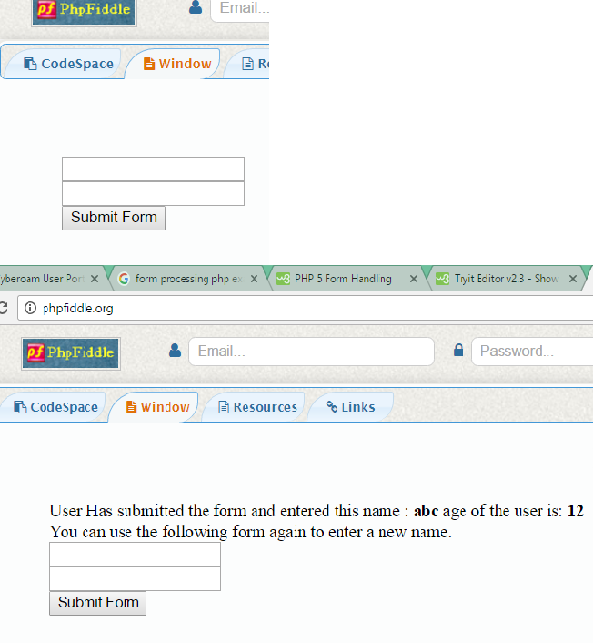
OUTPUT

Slide 53
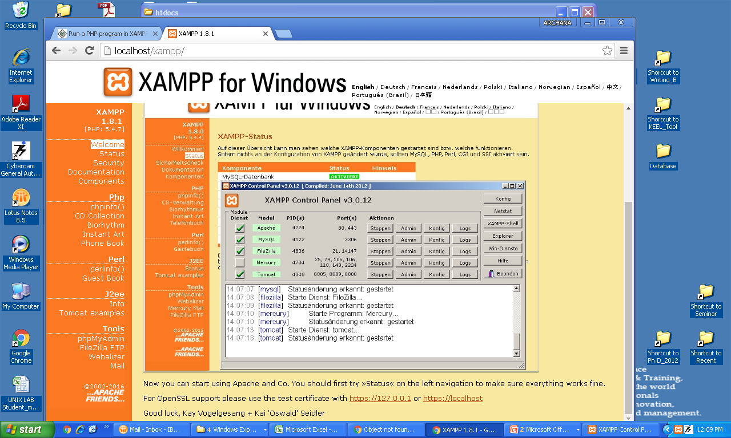
Type in web browser http://localhost

Slide 54
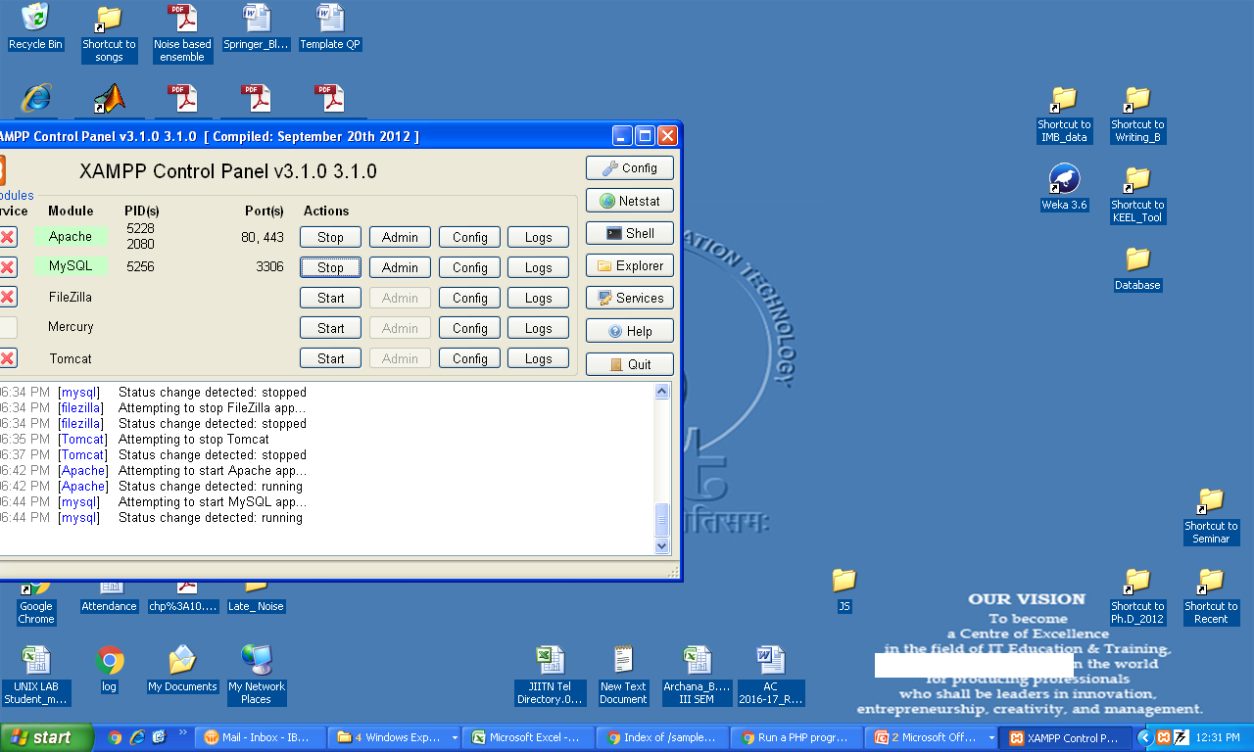
Go to XAMPP control panel and start the services

Slide 55
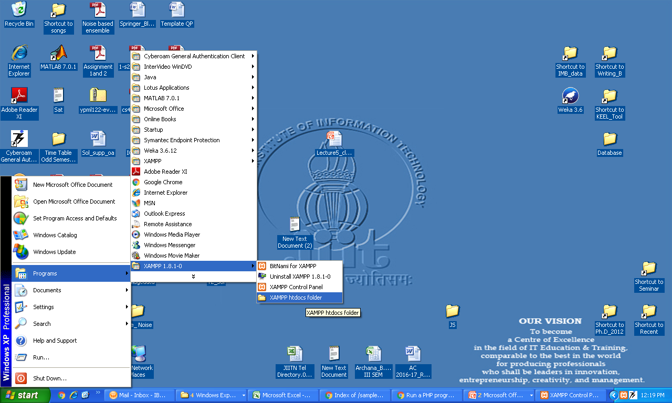
Make a folder(Sample) in htdocs folder and create the program test.php

Slide 56
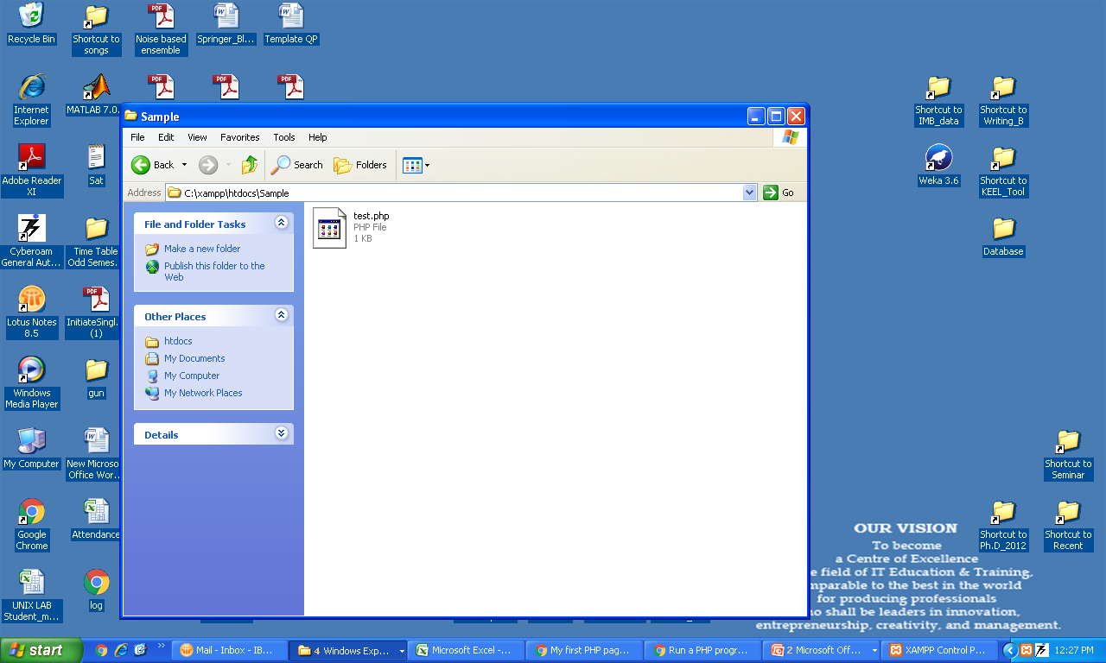
test.php

Slide 57
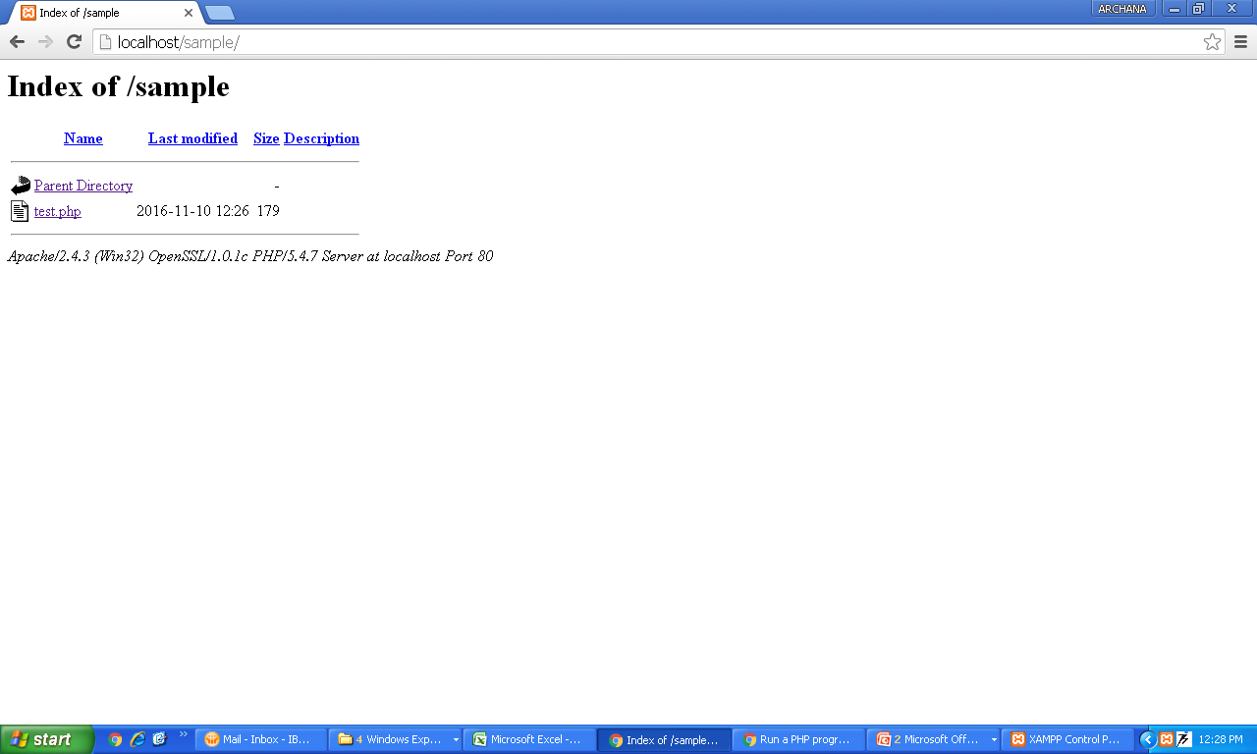
Step 1. Type in web browser http://localhost/Sample
Step 2. Click on test.php

Slide 58
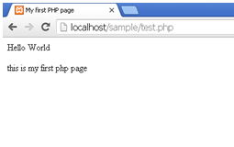
Click on test.php

Slide 59
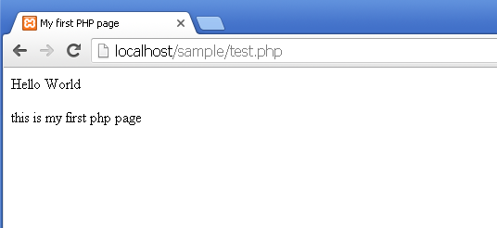
Ex 1
<html>
<head>
<title>My first PHP page</title>
</head>
<body>
<?php
//sample code
echo "Hello World"
?>
<p> this is my first php page </p>
</body>
</html>

Slide 60
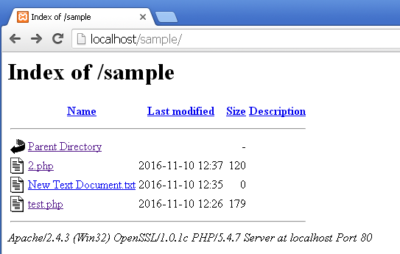
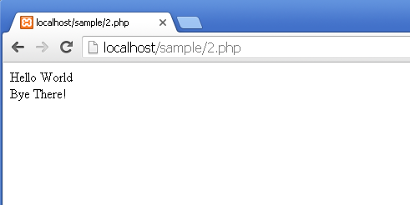
Ex 2
<?php
$txt = "World";
echo "Hello $txt";
$txt2 = "There";
echo”<br>”;
echo "Bye " . $txt2 . "!" ;
?>

Slide 61
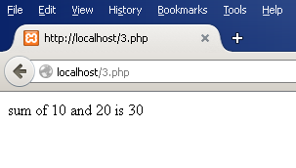
Ex 3
<?php
$x=10;
$y=20;
$z=$x+$y;
echo "sum of $x and $y is $z";
?>

Slide 62
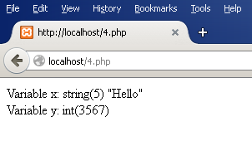
Ex 4
<?php
$x="Hello";
$y=3567;
echo "Variable x: ", var_dump($x),"<br>";
echo "Variable y: ", var_dump($y);
?>

Slide 64
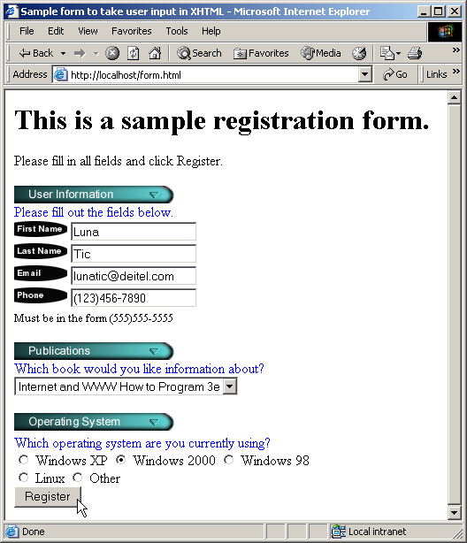
26.5 FORM PROCESSING AND BUSINESS LOGIC

Slide 65
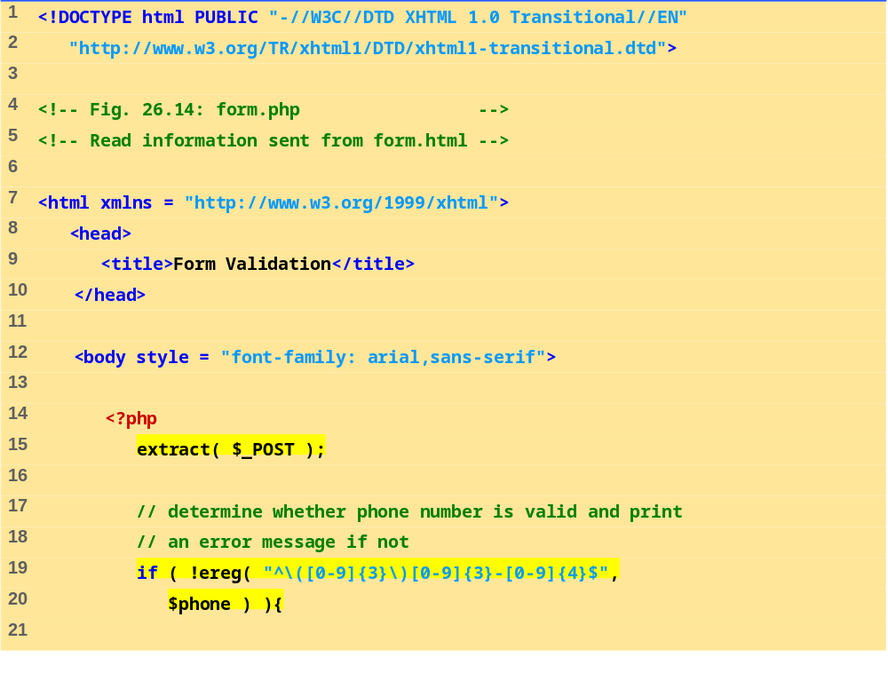
FORM.PHP
(1 OF 4)
Function ereg is called to determine whether the phone number entered by the user is valid.
The parentheses in the expression must be followed by three digits ([0-9]{3}), a closing parenthesis, three digits, a literal hyphen and four additional digits.
The expression \( matches the opening parentheses of a phone number.
We access the phone field’s value from form.html by using variable $phone.

Slide 66
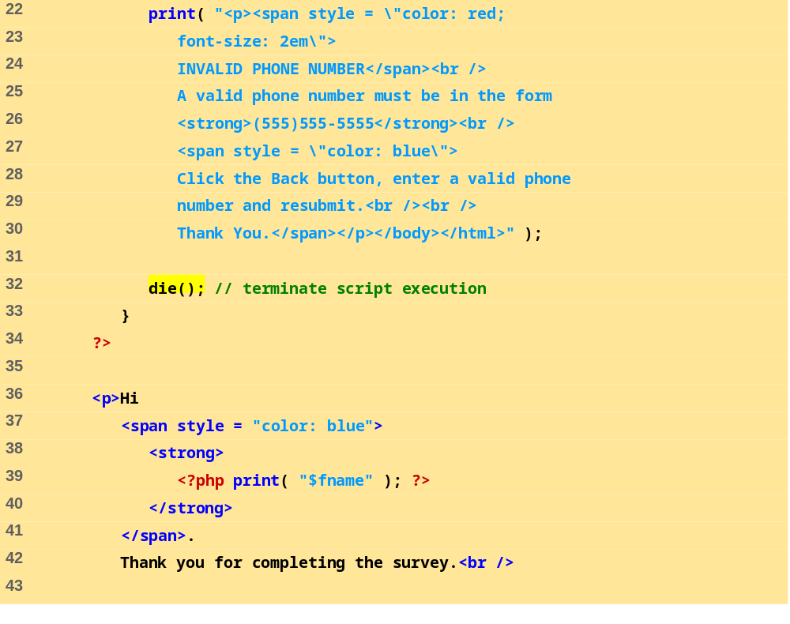
FORM.PHP
(2 OF 4)
Function die terminates script execution

Slide 67
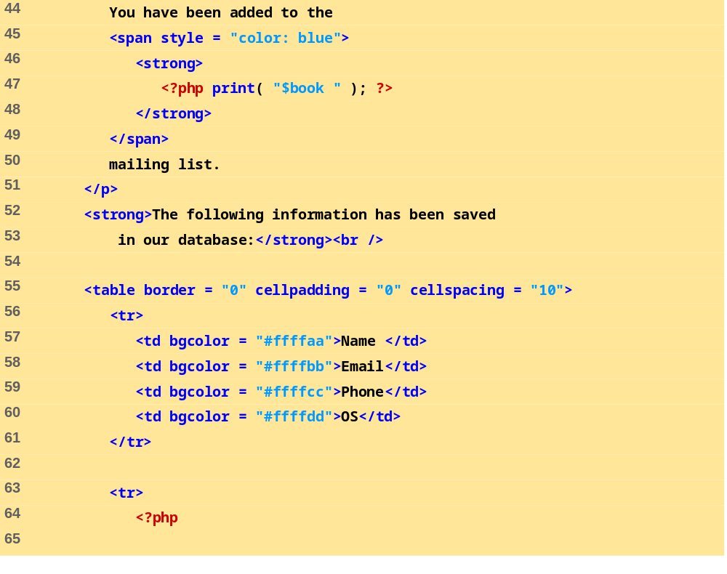
FORM.PHP
(3 OF 4)

Slide 68
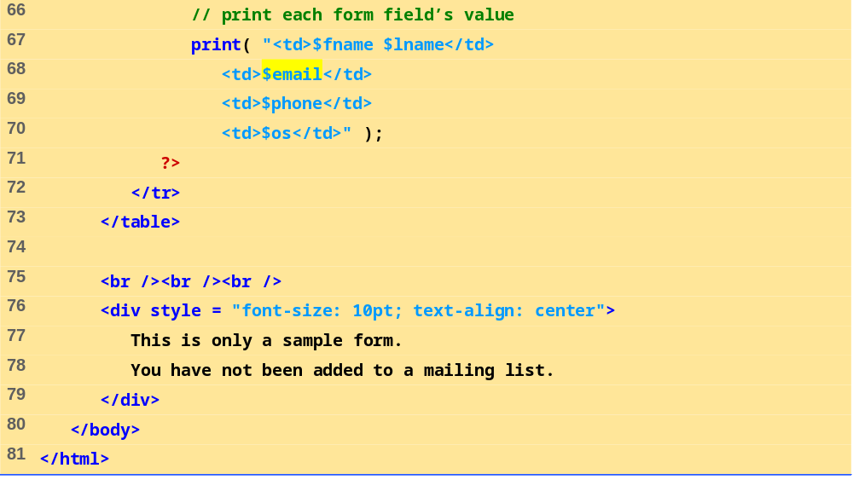
FORM.PHP
(4 OF 4)

Slide 69
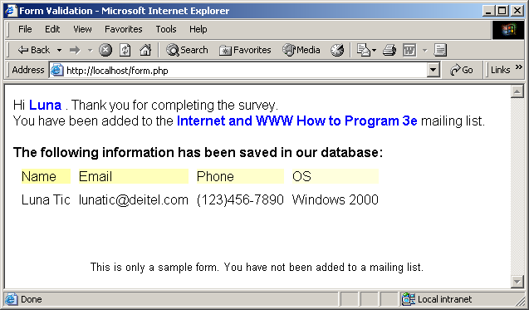
26.5 FORM PROCESSING AND BUSINESS LOGIC
Fig. 26.14 Obtaining user input through forms.

Slide 70
26.6 VERIFYING A USERNAME AND PASSWORD
Private website
  Only accessible to certain individuals
  Encrypt username and password data when sending, storing and retrieving for increased security
Implementing password checking
  Login information stored in file
    fopen function
    Read, write, append modes
  Store data using fputs
    \n newline character
  Close files when done
    fclose function

Slide 71
26.6 VERIFYING A USERNAME AND PASSWORD
Implementing password checking, cont.
  Trim newline character
    chop function
  Split string into substrings given a certain delimiter
    split function
  If username/password match list, allow access

Slide 72
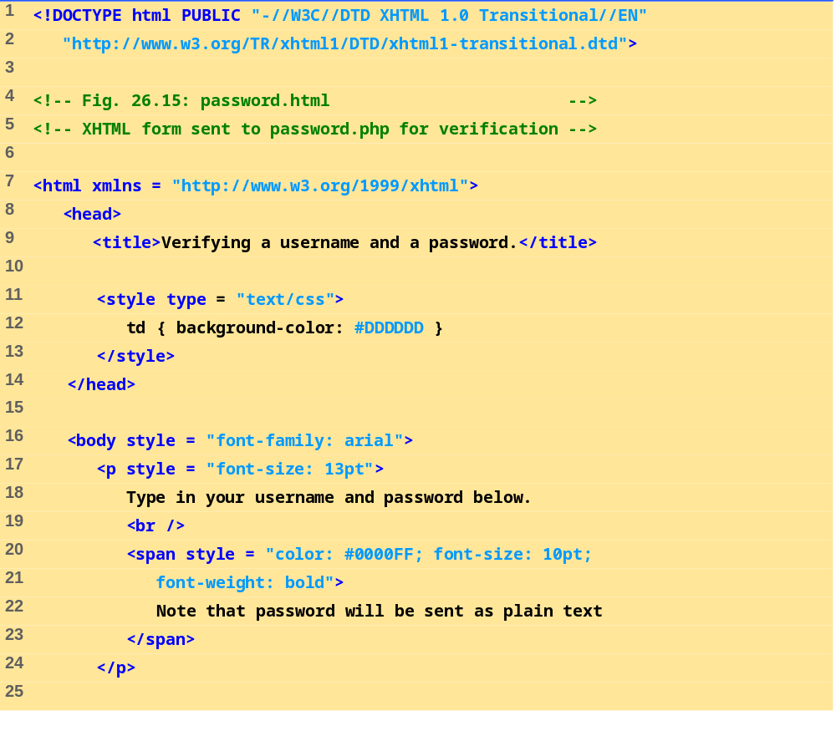
PASSWORD.HTML
(1 OF 4)

Slide 73
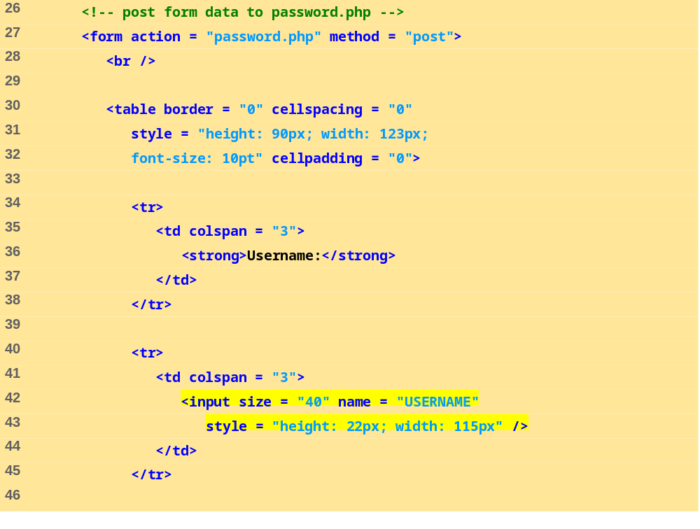
PASSWORD.HTML
(2 OF 4)
Form data is posted to password.php.

Slide 74
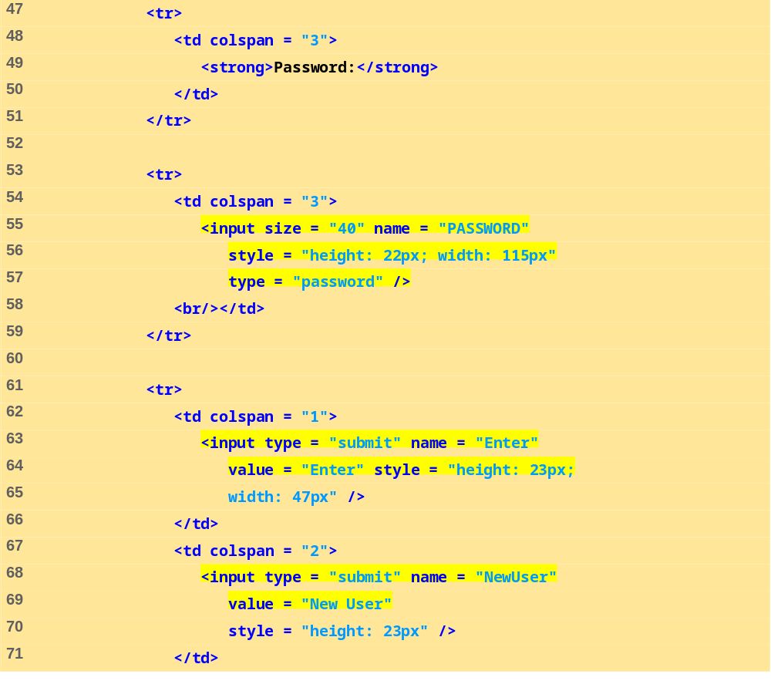
PASSWORD.HTML
(3 OF 4)

Slide 75
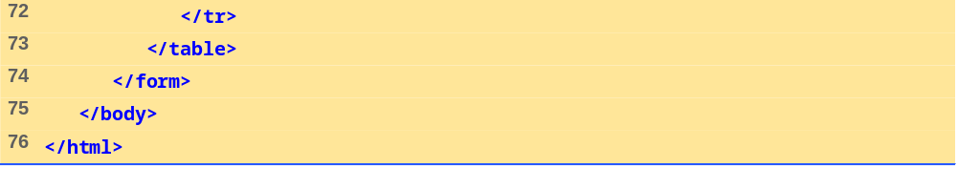
PASSWORD.HTML
(4 OF 4)

Slide 76
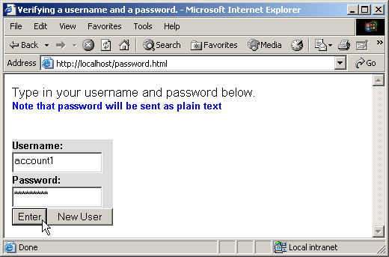
26.6 VERIFYING A USERNAME AND PASSWORD
Fig. 26.15 XHTML form for obtaining a username and password.

Slide 77
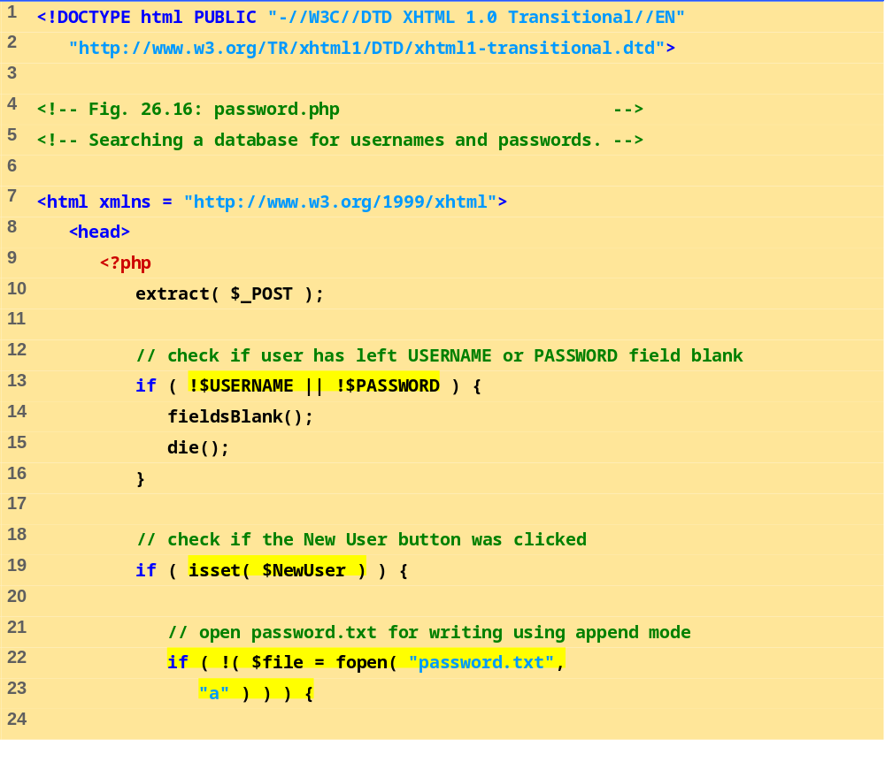
PASSWORD.PHP
(1 OF 7)
Variable names, when preceded by the logical negation operator (!), return true if they are empty or set to 0. This checks if a user has submitted a form without specifying a username or password.
Function fieldsBlank is called if the user has submitted an incomplete form to notify the user that all form fields must be completed.
Function isset tests whether the user has pressed the New User button, indicating that a new user must be added.
To add a new user, we open the file password.txt in append mode and assign the file handle that is returned to variable $file.

Slide 78
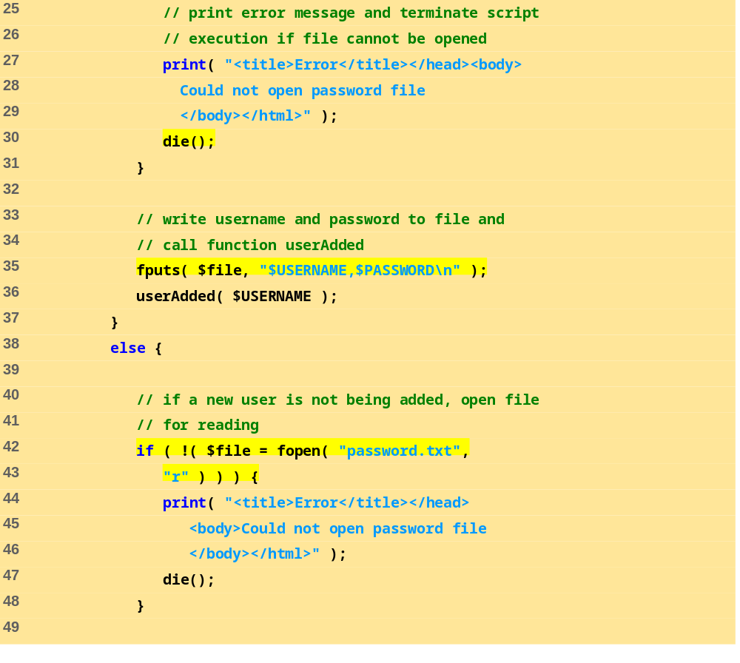
PASSWORD.PHP
(2 OF 7)
Print an error message and terminate script execution if the file cannot be opened.
Function userAdded is called to print a message to the user to indicate that the username and password were added to the file.
Function fputs writes the name and password to the text file..

Slide 79
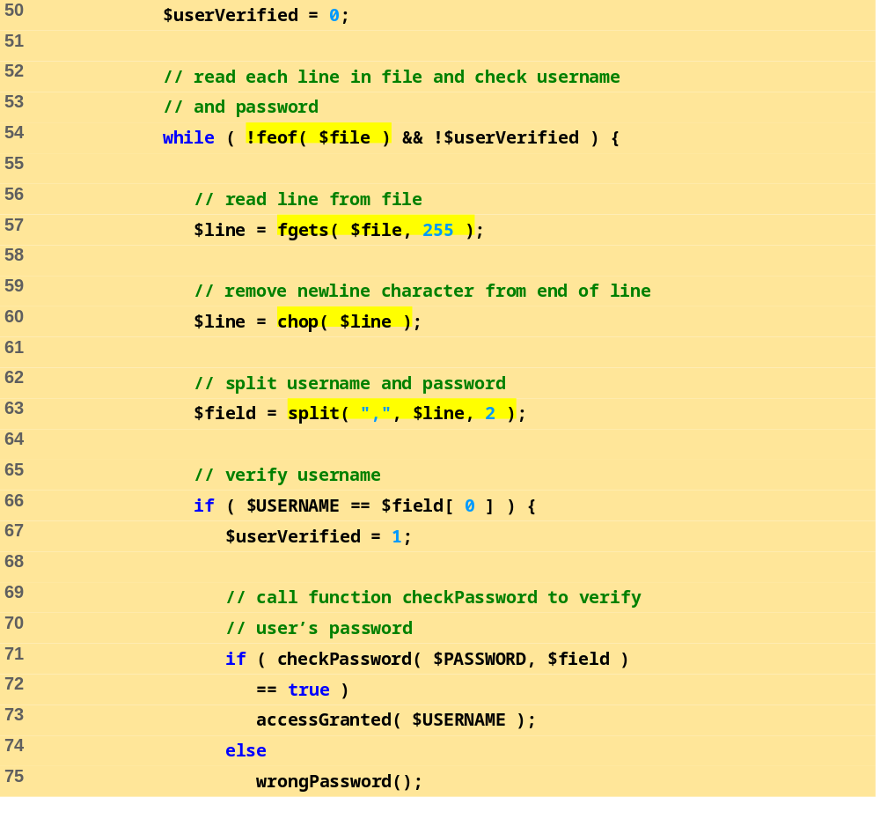
PASSWORD.PHP
(3 OF 7)
Before entering the while loop, variable $userVerified is set to 0.
Function fgets reads a line from the text file. The result is assigned to variable $line.
The while loop executes as long as the there are more lines in the file to read and variable $userVerified is still 0 or empty.
Function chop removes the newline character from the end of the line.
Function split is called to separate the string at the specified delimiter (in this case, a comma). The resulting array is stored in array $field.
The username entered by the user is tested against the one returned in the text file (stored in the first element of the array). If they match, variable $userVerified is set to 1.
If function checkPassword returns true, function accessGranted is called to notify the client that permission has been granted. Otherwise, function wrongPassword is called.
Function checkPassword is called to verify the user’s password. Variable $PASSWORD and array $field are passed to the function.

Slide 80
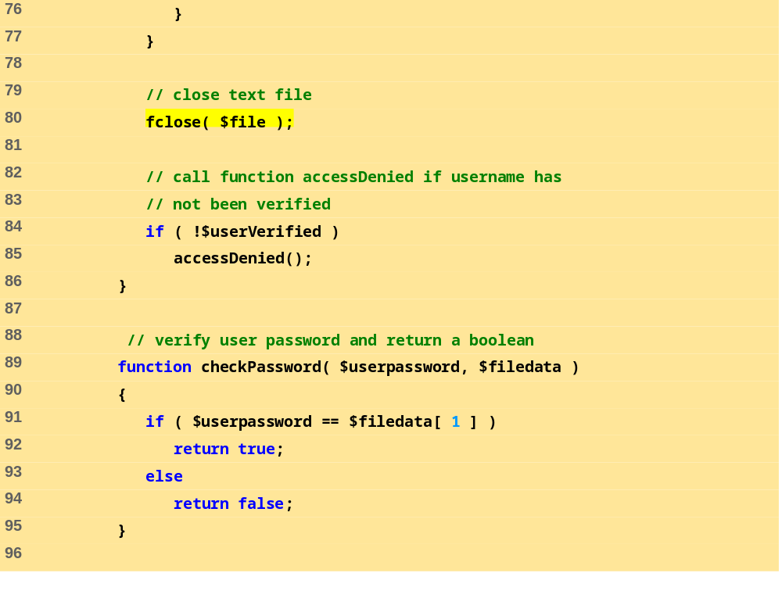
PASSWORD.PHP
(4 OF 7)
If variable $userVerified has not been set to a value other than 0, function accessDenied is called to notify the client that access has been denied.
After the while loop has executed, function fclose is called to close the file.
Function checkPassword compares the user’s password to the password in the file. If they match, true is returned, whereas false is returned if they do not.

Slide 81
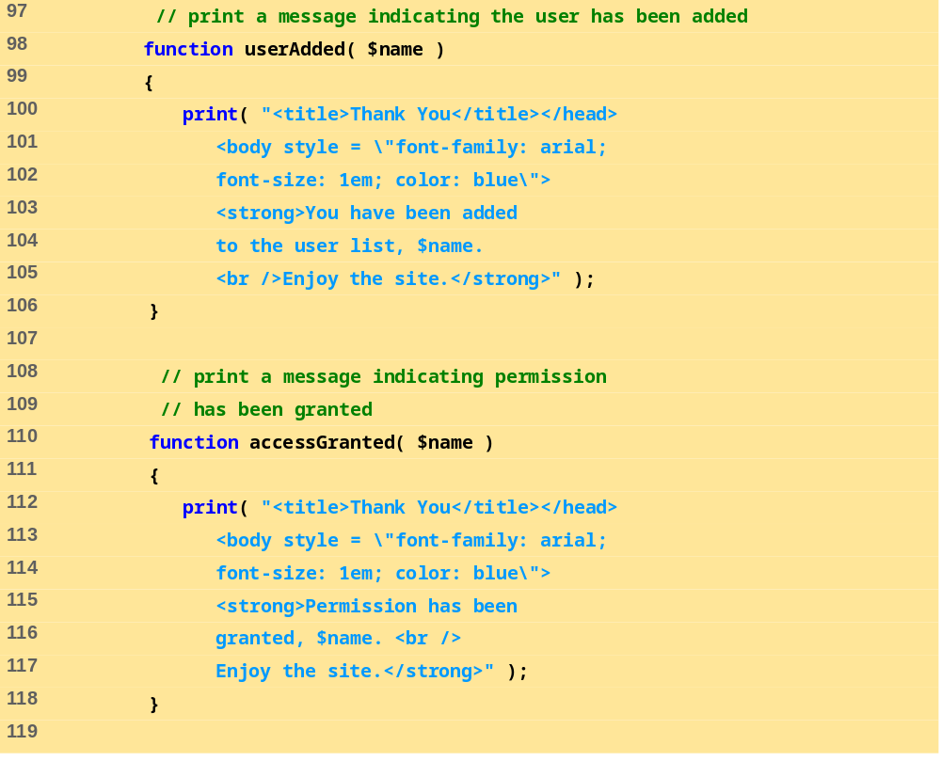
PASSWORD.PHP
(5 OF 7)
Function userAdded prints a message to the client indicating that the user has been added.
Function accessGranted prints a message to the client indicating that permission has been granted.

Slide 82
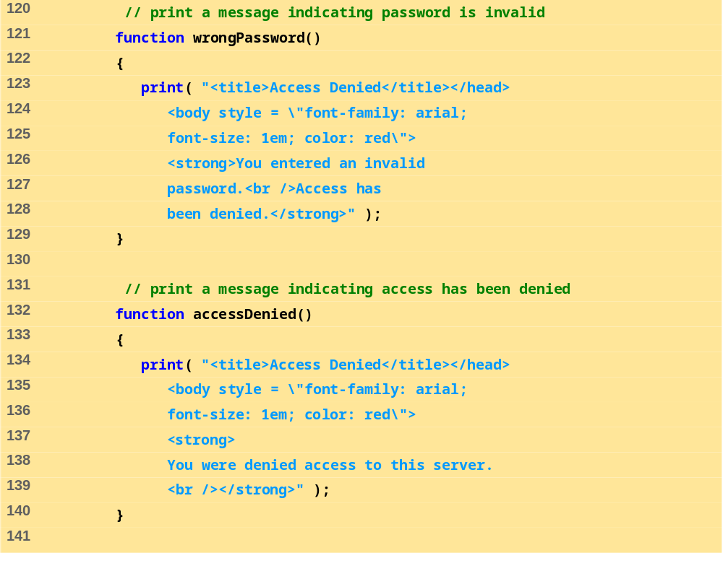
PASSWORD.PHP
(6 OF 7)
Function wrongPassword prints a message to the client indicating that the password is invalid.
Function accessDenied prints a message to the client indicating that access has been denied.

Slide 83
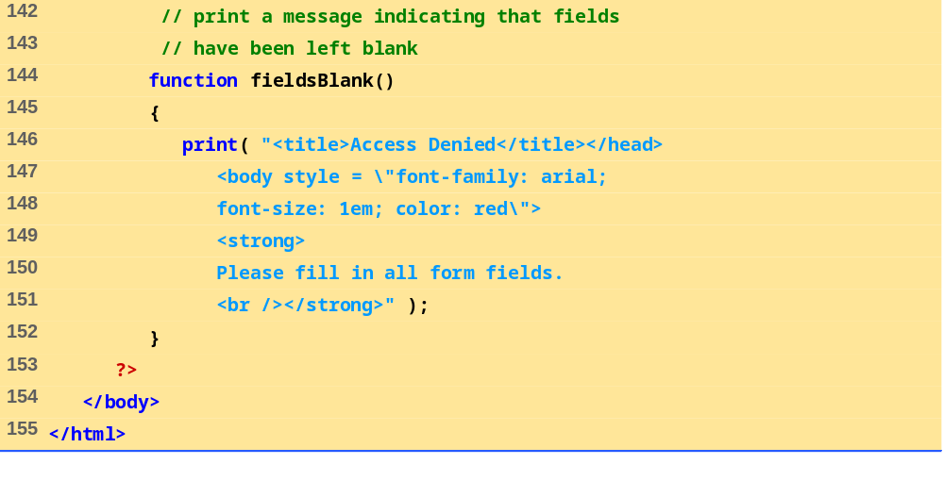
PASSWORD.PHP
(7 OF 7)
Function fieldsBlank prints a message to the client indicating that all form fields have not been completed.

Slide 84
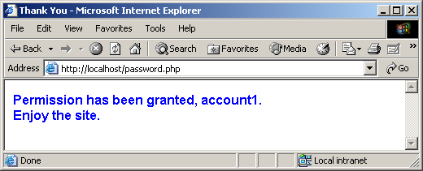
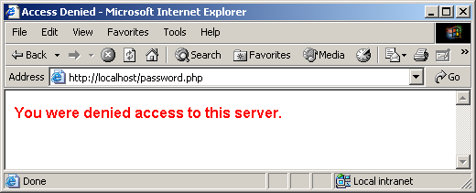
26.6 VERIFYING A USERNAME AND PASSWORD
Fig. 26.16 Verifying a username and password.

Slide 85

PASSWORD.TXT
(1 OF 1)

